Slide 1

Recruitment Process Optimisation: Transforming Hiring for 2026 and Beyond
Building a competitive advantage through strategic talent acquisition

Slide 2


THE CHALLENGE
The Recruitment Crisis: Why Speed and Quality Are at Risk
Slow, manual processes cause candidate drop-off and damage employer brand. Reactive "post-and-pray" hiring fails in today's competitive market.
44 Days Average
69% Shortage
Time-to-fill costing top talent and productivity (SHRM, 2025)
Employers reporting talent shortages (GMAC, 2024)

Slide 3
The Cost of Delay: What a Slow Hiring Process Really Means
10
£1000s
Days on Market
Daily Loss
Top candidates accept offers elsewhere before slow hirers decide
Each unfilled role costs thousands in lost productivity and revenue (SHRM)
Brand Damage
Competitive Reality
Poor candidate experience leads to negative reviews on Glassdoor and LinkedIn, poisoning your talent pipeline for years.
Companies lose A-players to faster competitors due to inefficient workflows and lengthy decision-making processes.

Slide 4
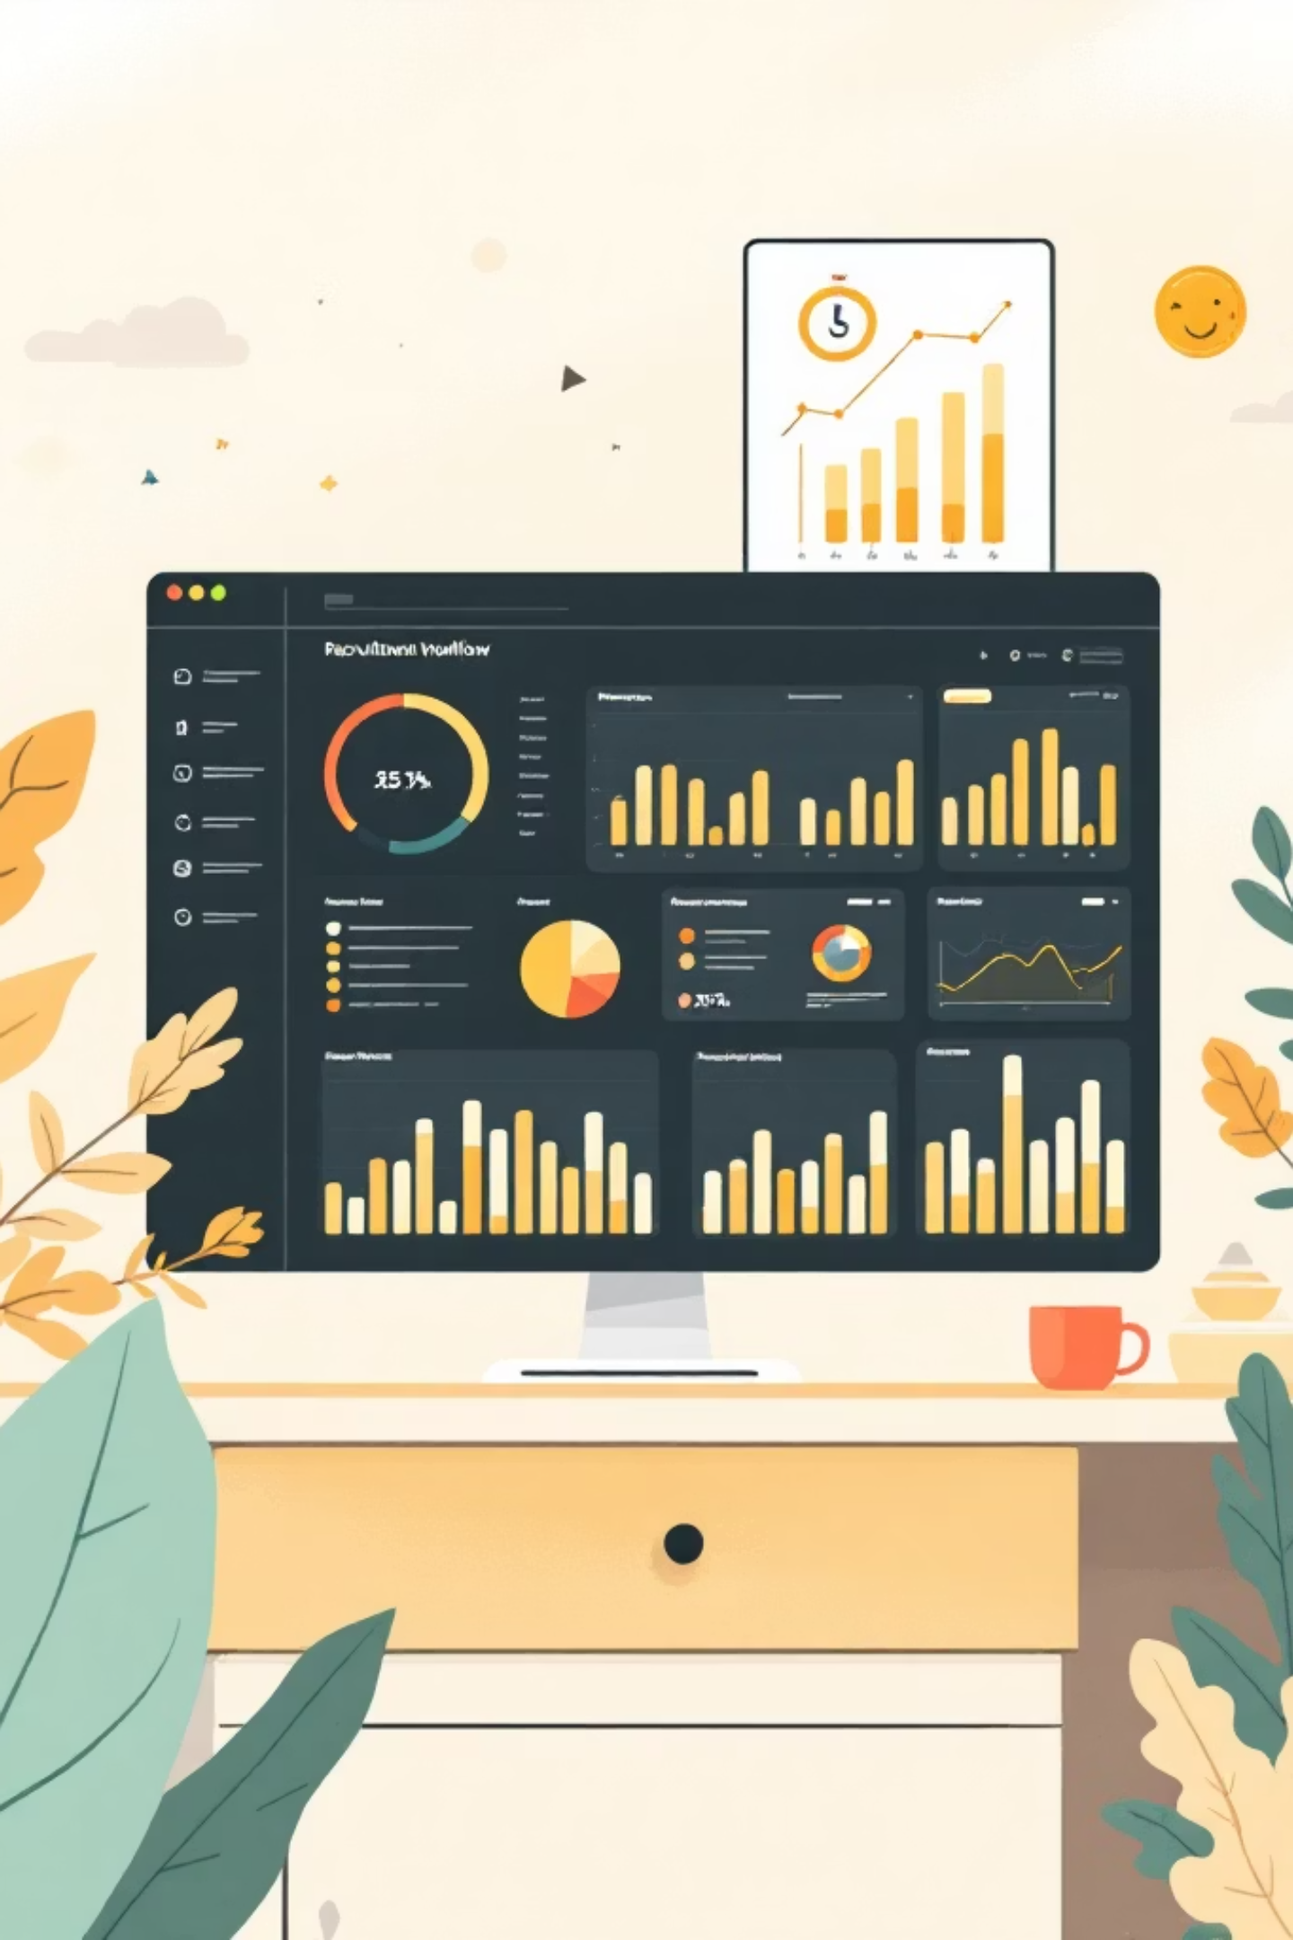

STEP 1
Audit Your Recruitment Workflow to Identify Bottlenecks
01
02
Map the Timeline
Measure Key Metrics
Chart your sourcing-to-offer journey to pinpoint delays in screening, interviewing, and decision-making stages
Track time-to-hire, stage conversion rates, and offer acceptance rate with data-driven precision
03
Identify Improvements
Use insights to eliminate waste and accelerate decision-making across your hiring funnel
Case Study: IT firm reduced manual screening by 80% using AI frameworks (Springer, 2024). Result: faster decisions, fewer lost candidates, improved hiring quality.

Slide 5
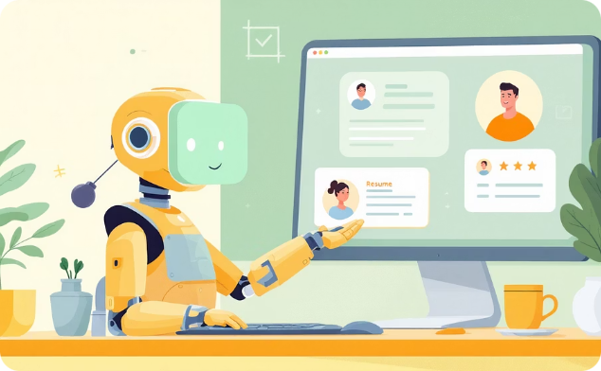


STEP 2
Build Proactive, AI-Powered Sourcing Engines
AI-Driven Search
Expanded Talent Pools
Competitive Edge
Tools like PeopleGPT search 800M+ profiles to find passive candidates beyond job boards
62% of top hires come from proactive sourcing, not inbound applications
Beat competitors to high-potential candidates and cut time-to-hire by 40% (TalentLab, 2025)

Slide 6
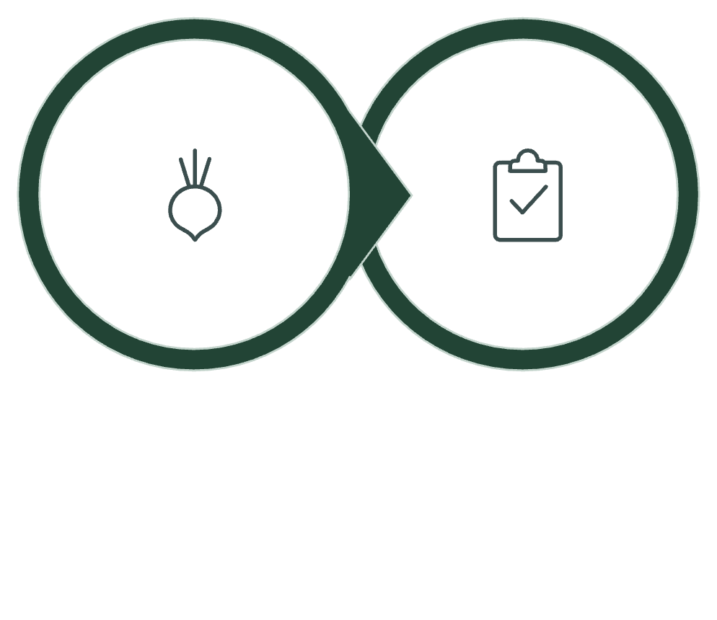
STEP 3
Automate Screening and Standardise Interviews
The Impact
Reduced Bias
Standardised processes ensure fair evaluation of all candidates
Higher Quality
Data-driven scoring identifies best-fit talent consistently
AI Scoring
Interview Kits
Faster Funnel
Automation transforms recruitment by eliminating repetitive manual tasks and enabling recruiters to focus on relationship-building.
Candidates progress quickly through streamlined stages
Source: Metaview, 2025

Slide 7

STEP 4
Leverage Data and Continuous Improvement
Track Metrics Religiously
Refine Based on Insights
Connect to Business Impact
Monitor time-to-fill, candidate response times, and stage drop-offs to identify improvement opportunities
Use data to optimise job descriptions, sourcing channels, and interview processes continuously
Organisations with engaged employees from good hiring practices are 23% more profitable (Gallup, 2024)
Example: Salary.com's AI tools help forecast hiring needs and optimise pay competitiveness, turning recruitment into strategic workforce planning.

Slide 8
TECHNOLOGY STACK
Tools and Technologies Powering Recruitment Optimisation
AI-Powered ATS
Scheduling Automation
Applicant Tracking Systems with AI assistance for job posting and messaging—used by 73% of firms to streamline workflows
Eliminate interview coordination ping-pong and accelerate the candidate journey with intelligent scheduling
Integrated Onboarding
Emerging Innovation
Background checks and e-signatures streamline offer processes and reduce time from acceptance to start date
Chatbots for candidate engagement and predictive analytics for workforce planning transform talent strategy

Slide 9
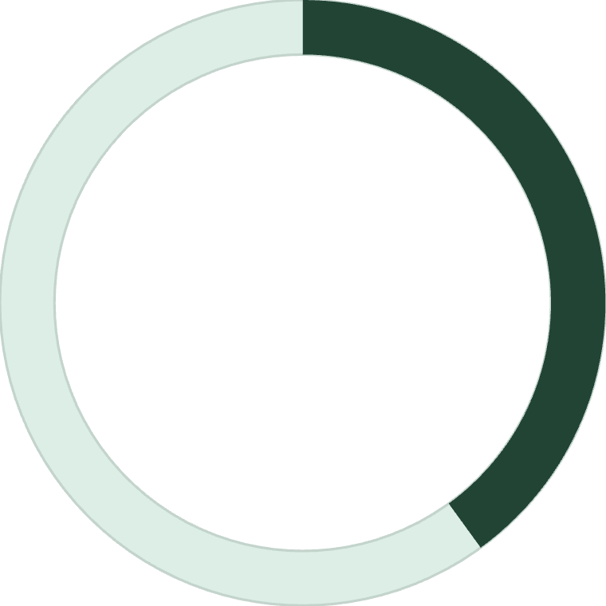

Real-World Impact: From Chaos to Competitive Advantage
40%
5%
Time Reduction
World-Class Status
Companies adopting AI and automation cut time-to-hire dramatically
Only 5% achieve elite talent acquisition—huge opportunity to lead
Improved candidate experience boosts employer brand and reduces costly turnover. Proactive recruitment pipelines ensure readiness for future talent needs, not just reactive hiring.
Result: Thousands of hours saved annually, stronger talent pipeline, and sustainable competitive advantage.

Slide 10

The Future Is Now: Your Recruitment Optimisation Playbook
Invest in AI
Audit Today
Deploy AI-powered sourcing and screening tools to find and engage top talent faster
Identify bottlenecks in your current process and measure baseline metrics
Refine Continuously
Standardise & Automate
Use data-driven insights to scale your recruitment engine and win the war for talent in 2026 and beyond
Implement structured interviews and automate routine tasks to improve quality and fairness

